Slide 1
ISO/TC211 Ad Hoc Group on best practices for UML modelling
Sydney, Australia 2015-12-09

Slide 2
Agenda
Wed 2015-12-09 | Meeting of ad hoc group
11:00 | 1. Welcome and introduction | Convenor
 | 2. Roll call of members | Members
 | 3. Approval of agenda | Members
 | 4. Minutes of meeting for the Southampton meeting | Convenor
 | 5. Progress report | Convenor
 | 6. Discussion on registered issues (https://github.com/ISO-TC211/UML-Best-Practices/issues) | Members
 | 7. Discussion on issues to add | Members
 | 8. Revised action plan for the group | Convenor, Members
12:30 | Close – with possibility to continue discussions in the HMMG Meeting

Slide 3
GitHub https://github.com/ISO-TC211/UML-Best-Practices
https://github.com/ISO-TC211/UML-Best-Practices
For reference documents, scripts, illustrations etc.
https://github.com/ISO-TC211/UML-Best-Practices/wiki
Wiki for UML Best practices
https://github.com/ISO-TC211/UML-Best-Practices/issues
For issue tracking

Slide 4
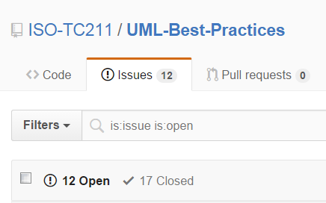
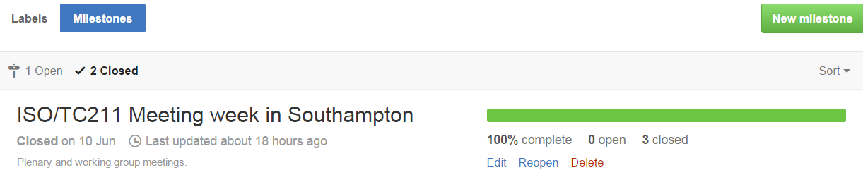

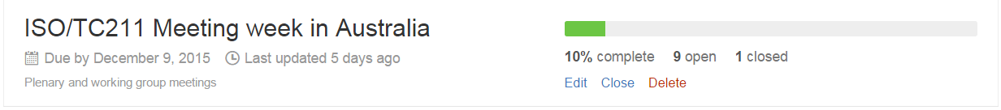
Progress report

Slide 5
Status
Much work done on diagram design
Few issues open
Much work done on modelling
Several issues open
Much work done on documentation
Much work done on scripts and tools
Scripts in VBScript, JScript, searches (XML)
Several contributors have scripts that have been uploaded
Much work done on basic UML
Relevant requirements and recomendations
Levels of abstraction
Few issues open
Much left to do on implementation issues
Few issues open

Slide 6
Issues for discussion
Versions of models
Morten – Documentation
Roland – Associations
Anthony – IHO – Backwards compatibility
https://github.com/ISO-TC211/UML-Best-Practices/issues
New issues?

Slide 7

Revised action plan
Continue as AHG up to the next plenary (June 2016)
Adopt into the HMMG
Continue the work
Wiki to be moved to official ISO/TC211 Wiki in the future

